Slide 1
OPTIMUS: Organizing Sentences via Pre-trained Modeling of a Latent Space
Reported by Chenghong Li 2020.09.17

Slide 2
OPTIMUS
ATAI
1. Background 2. Pre-training 3. Experiments 4. Conclusion

Slide 3
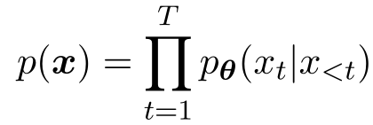
Background
ATAI
To generate a text sequence of length T, x = [x1,· · · , xT], neural language models generate every token xt conditioned on the previous word tokens:
The text generation process only depends on previous word tokens, and there is limited capacity for the generation to be guided by the higher-level structures that are likely presented in natural language, such as tense, topics or sentiment.

Slide 4
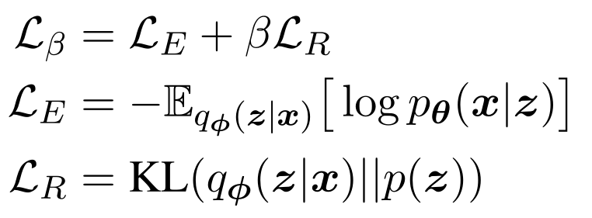
Pre-training
ATAI

Slide 5
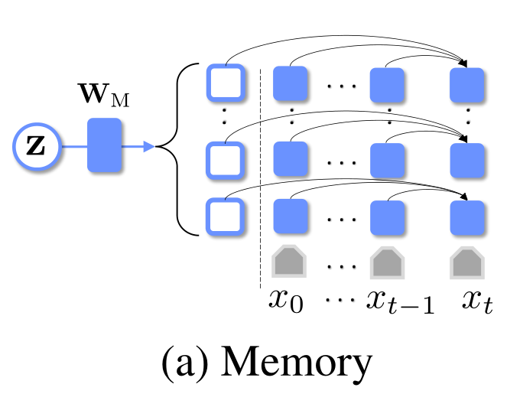
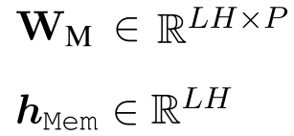
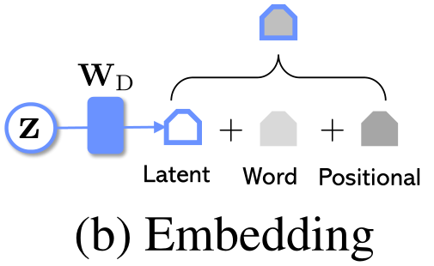
Pre-training
ATAI
BERT(L=12, H=768, A=12)
GPT-2 (L=12, H=768,A=12)
L： number of layers
H ：hidden size
A ：number of self-attention heads

Slide 6
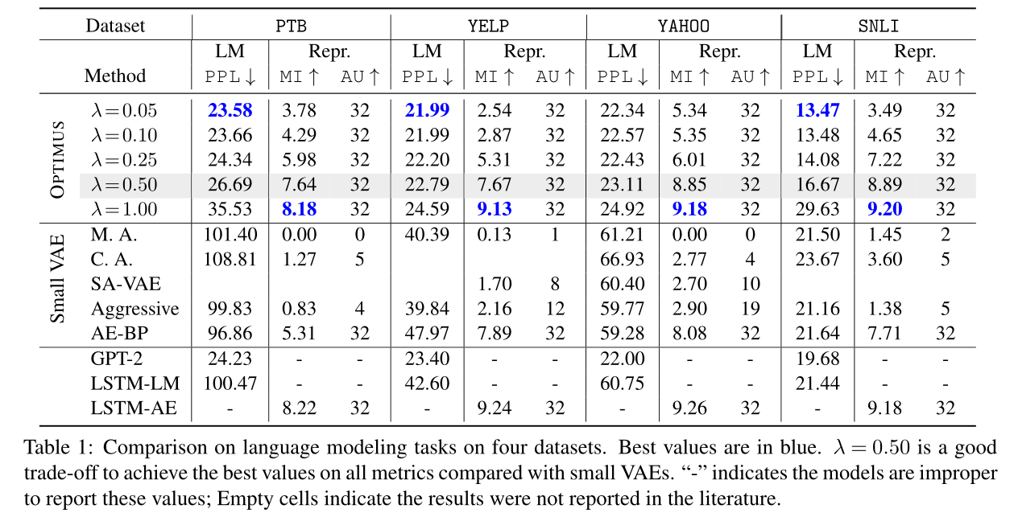
Experiments : Language Modeling
ATAI

Slide 7
Experiments : Arithmetic operation
ATAI

Slide 8
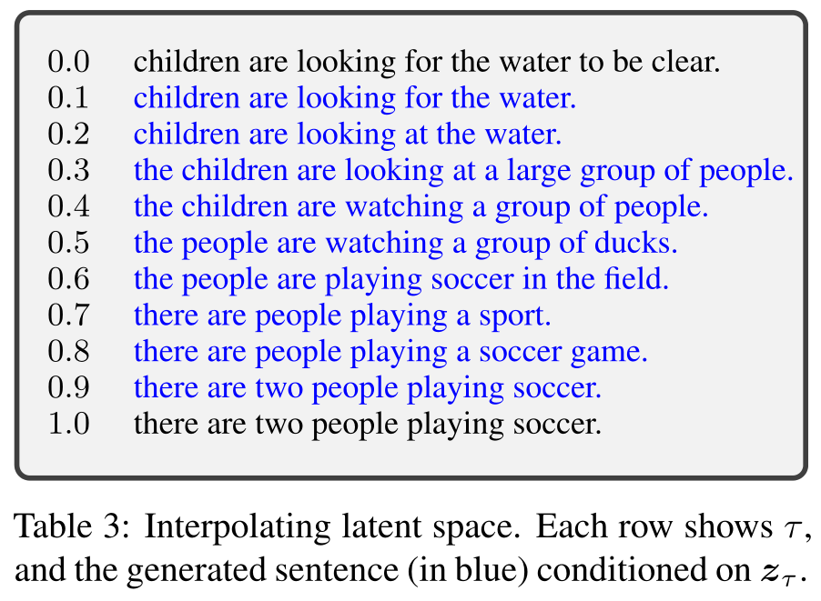
Experiments : Latent space interpolation
ATAI

Slide 9
Experiments
ATAI
Dataset：Dailydialog & Yelp
Dialog response generation
Stylized response generation
Label-conditional text generation

Slide 10
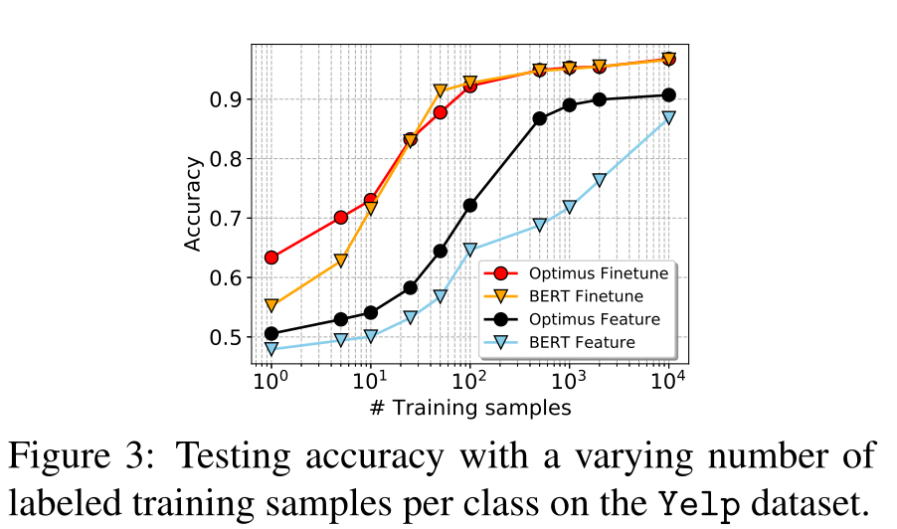
Experiments : Low-resource Language Understanding
ATAI

Slide 11
Conclusion
ATAI
We present OPTIMUS, a large-scale pre-trained deep latent variable model for natural language.
It introduces a smooth and universal latent space, by combining the advantages of VAEs, BERT and GPT-2 in one model.

Slide 12
THANGKS!

